Slide 1
HISTORY OF PLANT BIOTECHNOLOGY

Slide 2
Early Plant breeding
Humans domesticate crops.
• Breed plants to further improve desirable
Characteristics
The word "biotechnology" was first used in 1917 to describe
processes using living organisms to make a product or run a
process, such as industrial fermentations. In fact,
biotechnology began when humans started to plant their own
crops, domesticate animals, ferment juice into wine, make
cheese, and leaven bread.
Present definition of biotechnology
“Any technological application that uses biological systems,
living organisms, or derivatives theory, to make or modify
products or processes for specific use’’

Slide 3
Plant breeding 12,000 years ago …

Slide 4
Bread-making wheat grown in Egypt, rice cultivated in China

Slide 5
Artificial selection of kernel
oil content

Slide 6
Plant Biotechnology
Plant biotechnology is founded on the principles of cellular totipotency and genetic transformation.
Traced back to the Cell Theory of M.J.Schleiden and T.Schwann.
Discovery of the genetic transformation in bacteria by Frederick Griffith.
Plant biotechnology
“Plant biotechnology describes a precise process in which scientific techniques are used to develop useful and beneficial plants’’

Slide 7
Introduction
Eighteenth Jan 1983, three independent groups described Agrobacterium tumefaciens-mediated genetic transformation, leading to the production of normal, fertile transgenic plants.
Introduced a bacterial antibiotic resistance gene into tobacco.

Slide 8
Objective
Scientists believe that the new technology would allow introduction of agronomically important genes into crop species that are susceptible to agro-bacterial infections.

Slide 9
THE CELL THEORY
Schleiden & Schwann

Slide 10
Schleiden (1838):
Every plant and animal is “an aggregate of fully individualized, independent, separate beings”, that is, cell.

Slide 11
Schwann (1839):
“Some of these elementary parts (cells) which do not differ from others, are capable of being separated from the organism and continuing to grow independently.”

Slide 12
Cell Theory:
All living things are composed of cells.
Cells are the basic unit of structure and function in living things.
Cells arise from pre-existing cells.

Slide 13
Virchow (1858):
“Where a cell arises, there must have been a cell before, even as an animal can come from nothing but an animal, a plant from nothing but a plant…nor can any developed tissue be traced back to anything but a cell”

Slide 14
Revival of Cell Theory:
Interest in the Cell Theory was revived in 1858 by the famous aphorism of Ludwig Karl Virchow:
“Omnis cellula a cellula” (all cells arise from cells).
He determined that diseased cells always arose from healthy cells, and rejected the prevailing view of spontaneous generation.

Slide 15
Revival of Cell Theory:
Herman Vöchting (1878), attempted to demonstrate totipotency experimentally by dissecting and growing smaller and smaller fragments of plant tissues.

Slide 16
TOTIPOTENCY
Gottlieb Haberlandt

Slide 17
Totipotency
Totipotency is the ability of a single cell to divide and produce all the differentiated cells in an organism, including extra embryonic tissues.

Slide 18
Totipotency of Plant Cell
Gottlieb Haberlandt was the first to try to obtain experimental evidence of totipotency by culturing plant cells in nutrient solutions in hope of regenerating whole plants.

Slide 19
Gottlieb Haberlandt Experiment
He cultured chloroplast containing differentiated cells from leaves of Lamium purpureum in Knop’s solution in hanging drop cultures.

Slide 20
Results
The cells grew in size but did not undergo any cell divisions. eventually the cultures were lost to infection.
He failed largely because of his unfortunate choice of experimental material, and because of inadequacy of nutrition provided by Knop’s salt solution.

Slide 21
Predictions made by Gottlieb Haberlandt
He advocated the use of embryo sac fluids(Coenocytic liquid endosperm, such as coconut milk that was later used in tissue culture).
Inducing cell divisions in vegetative cells.

Slide 22
Discovery of Plant Growth Substances
Charles Darwin(1880) was one of the first to observe and describe the curvature of seedlings towards light.
Effect could be prevented by covering the tip of the colioptile.
The hormone later to be identified as naturally occurring auxin,IAA.

Slide 23
Auxins
Auxins are a class of plant growth substance (often called phytohormone or plant hormone). Auxins play an essential role in coordination of many growth and behavioral processes in the plant life cycle.
https://www.youtube.com/watch?v=AJ4OY9Jg5Kc

Slide 24
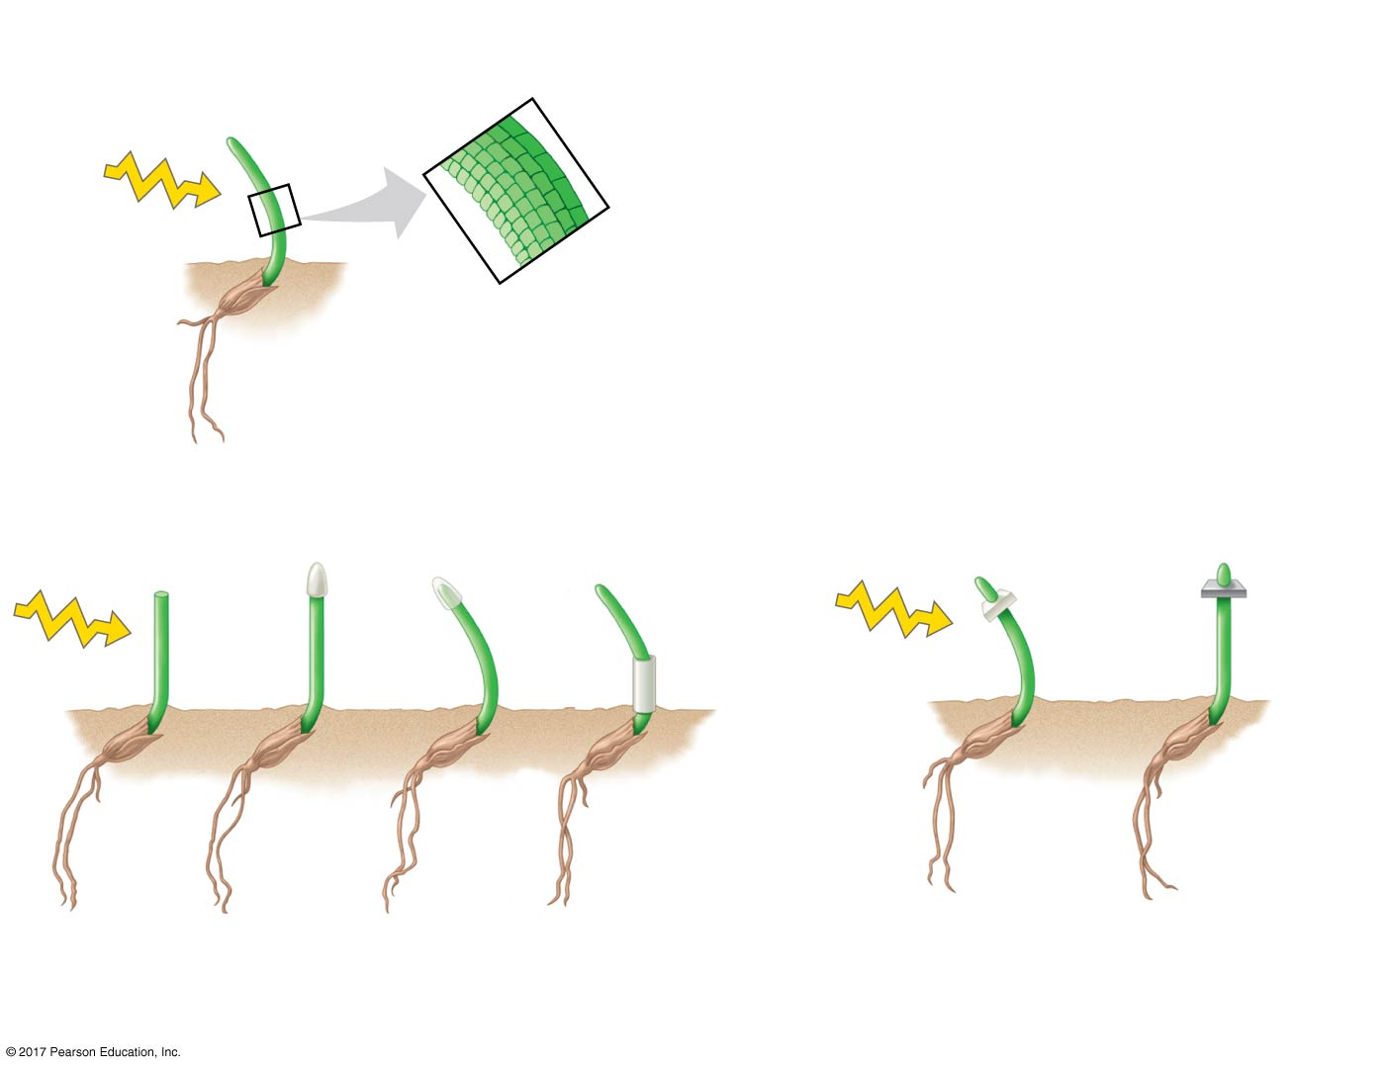
Figure 39.5
Results
Control
Shaded
side
Light
Illuminated
side
Darwin and Darwin
Boysen-Jensen
Light
Light
Tip
removed
Opaque
cap
Trans-
parent
cap
Opaque
shield over
curvature
Gelatin
(permeable)
Mica
(impermeable)
Data from C. R. Darwin, The power of movement in plants, John Murray, London (1880). P. Boysen-Jensen,
Concerning the performance of phototropic stimuli on the Avenacoleoptile, Berichte der Deutschen
Botanischen Gesellschaft (Reports of the German Botanical Society) 31:559–566 (1913).
© 2018 Pearson Education Ltd.
Notes:
Figure 39.5 Inquiry: What part of a grass coleoptile senses light, and how is the signal transmitted?

Slide 25
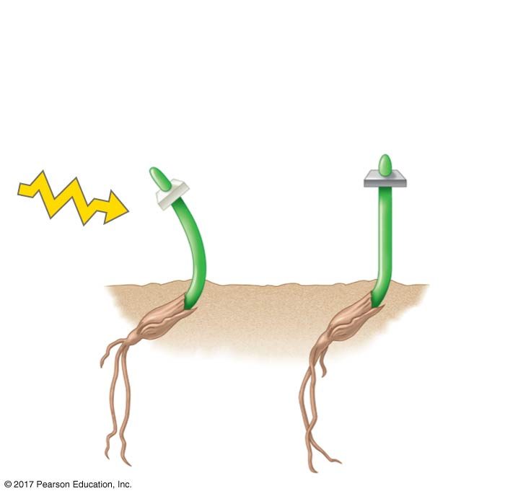
Figure 39.5c
Boysen-Jensen: Phototropism
occurs when the tip is separated by
a permeable barrier but not an
impermeable barrier.
Light
Gelatin
(permeable)
Mica
(impermeable)
© 2018 Pearson Education Ltd.
Notes:
Figure 39.5c Inquiry: What part of a grass coleoptile senses light, and how is the signal transmitted? (part 3: Boysen-Jensen)

Slide 26
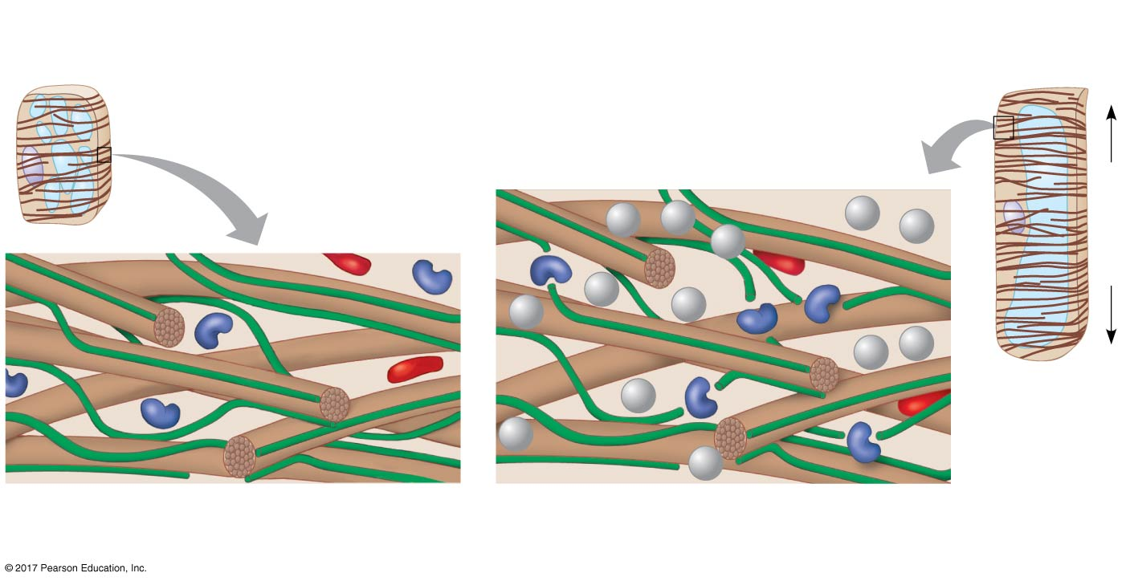
Figure 39.7
Cell wall before auxin activates proton pumps
Loosening of cell wall, enabling elongation
Cellulose
microfibrils
1
Auxin increases
activity of proton
pumps.
2
Low pH activates
expansins (red).
Elongation
PLANT CELL
WALL
H⁺
H⁺
H⁺
Nucleus
Vacuoles
H⁺
H⁺
H⁺
H⁺
H⁺
H⁺
H⁺
H⁺
H⁺
H⁺
Cellulose microfibril
Cross-linking
polysaccharide
3
Polysaccharides are cleaved by cell wall-loosening
enzymes (purple), loosening the microfibrils (brown).
© 2018 Pearson Education Ltd.
Notes:
Figure 39.7 Cell elongation in response to auxin: the acid growth hypothesis

Slide 27
Cytokinins
In addition to auxins another compound is cytokinins having profound impact on the culture of isolated plant cells.
They were discovered by Folk Skoog and his colleagues at the university of Wisconsin

Slide 28
Control of Cell Division and Differentiation
Cytokinins are produced in actively growing tissues such as roots, embryos, and fruits
Cytokinins work together with auxin to control cell division and differentiation

Slide 29
Anti-aging Effects
Cytokinins slow the aging of some plant organs by inhibiting protein breakdown, stimulating RNA and protein synthesis, and mobilizing nutrients from surrounding tissues
Gibberellins
Gibberellins have a variety of effects, such as stem elongation, fruit growth, and seed germination
Stem Elongation
Gibberellins are produced in young roots and leaves
Gibberellins stimulate growth of leaves and stems by enhancing cell elongation and cell division
Bolting, rapid growth of the floral stalk, is induced by gibberellins

Slide 30
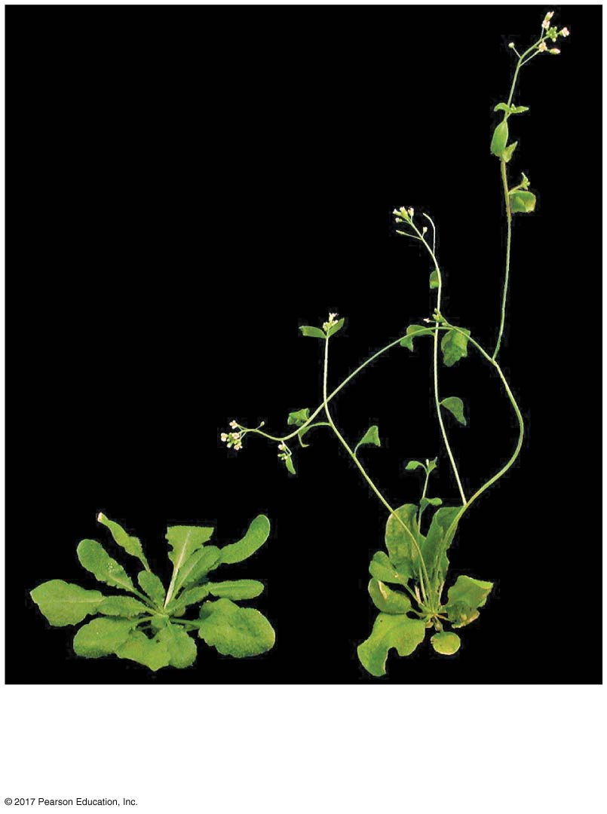
Figure 39.9a
(a) Rosette form (left) and
gibberellin-induced bolting (right)
© 2018 Pearson Education Ltd.
Notes:
Figure 39.9a Effects of gibberellins on stem elongation and fruit growth (part 1: bolting)

Slide 31
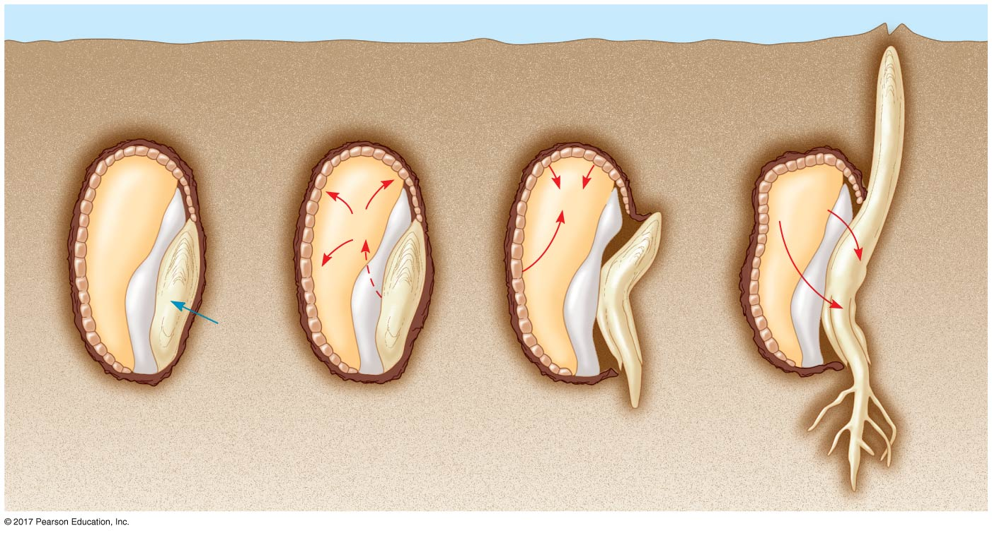
Figure 39.10
Aleurone
Endosperm
1
2
3
α-amylase
Sugar
GA
GA
Water
Scutellum
(cotyledon)
Radicle
© 2018 Pearson Education Ltd.
Notes:
Figure 39.10 Mobilization of nutrients by gibberellins during the germination of grain seeds such as barley

Slide 32
Abscisic Acid
Abscisic acid (ABA) slows growth, often by antagonizing the actions of growth hormones
ABA has many other effects on plants including seed dormancy and drought tolerance

Slide 33
Seed Dormancy
Seed dormancy increases the likelihood that the seed will germinate only in optimal conditions
Many dormant seeds germinate when ABA is removed or inactivated
The ratio of ABA to gibberellins often affects whether seeds will break dormancy
Precocious (early) germination can be caused by inactive or low levels of ABA

Slide 34
Drought Tolerance
ABA is the primary internal signal that enables plants to withstand drought
ABA accumulation in wilting leaves causes stomata to close rapidly
Transport of ABA from water-stressed root systems to leaves can act as an “early warning system”

Slide 35
Ethylene
Plants produce ethylene in response to stresses such as drought, flooding, mechanical pressure, injury, and infection
The effects of ethylene include response to mechanical stress, senescence, leaf abscission, and fruit ripening

Slide 36
The Triple Response to Mechanical Stress
Ethylene is produced when a seedling tip pushes against an obstacle
The production of ethylene induces a triple response in which stem elongation is slowed, the stem thickens, and the stem begins to grow horizontally
Vertical growth resumes when the effects of the ethylene wear off

Slide 37
Senescence
Senescence is the programmed death of certain cells or organs or entire plants
A burst of ethylene is associated with the onset of apoptosis, programmed cell death
Leaf Abscission
A change in the balance of auxin and ethylene controls leaf abscission, the process that occurs in autumn when a leaf falls

Slide 38
More Recently Discovered Plant Hormones
Brassinosteroids are chemically similar to cholesterol and the sex hormones of animals
They induce cell elongation and division in stem segments and seedlings at low concentration
They slow leaf abscission and promote xylem differentiation

Slide 39
Jasmonates, including jasmonate (JA) and methyl jasmonate (MeJA) play important roles in plant defense and development
They are produced in response to wounding and are involved in controlling plant defenses

Slide 40
Jasmonates also regulate many other physiological processes, including
Nectar secretion
Fruit ripening
Pollen production
Flowering time
Seed germination
Root growth
Tuber formation
Mycorrhizal symbiosis
Tendril coiling

Slide 41
Genetic Transformation

Slide 42
Genetic Transformation
A process by which the genetic material carried by an individual cell is altered by the incorporation of foreign (exogenous) DNA into its genome.

Slide 43
Genetic Transformation
Genetic Transformation was discovered by chance not by design by Frederick Griffith in 1928.
He was trying to develop a vaccine for prevention of pneumonia epidemic.

Slide 44
Frederick Griffith Experiment
Organism used was Streptococcus pneumoniae
He used two different strains of Streptococcus pneumoniae
R strain (Rough type)
S strain (Smooth type)

Slide 45
Griffith’s Experiment
He injected mice with R strain and S strain.
The mice injected with S strain develop pneumonia and died after few days, while those infected with R strain remains healthy.
Mice injected with a mixture of inactivated S strain and normal R strain developed pneumonia.

Slide 46
Griffiths Results
He postulated that some unknown “Transforming Principle” from the inactivated S strain had converted the non-capsulated non-virulent R strain into encapsulated and virulent S strain.

Slide 47
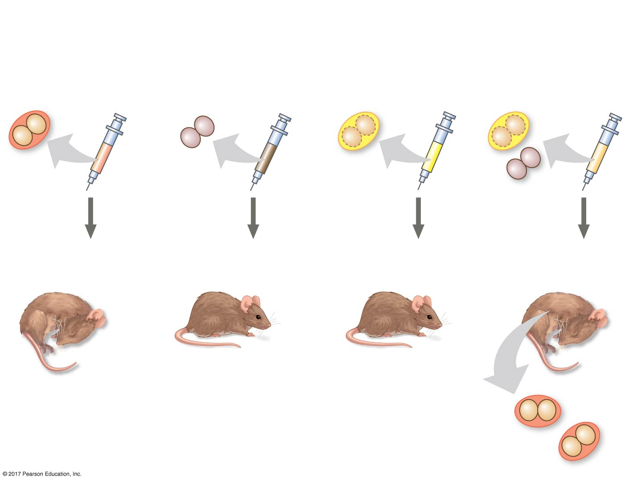
Figure 16.2
Experiment
Living S cells
(pathogenic
control)
Living R cells
(nonpathogenic
control)
Heat-killed S cells
(nonpathogenic
control)
Mixture of heat-
killed S cells and
living R cells
Results
Mouse dies
Mouse healthy
Mouse healthy
Mouse dies
Living S cells
© 2018 Pearson Education Ltd.
Notes:
Figure 16.2 Inquiry: Can a genetic trait be transferred between different bacterial strains?

Slide 48
Purpose of Genetic Transformation
To improve the quality of crops
To improve the productivity of crops in order to meet increasing demands of food.

Slide 49
Today plant biotechnology encompasses two major areas:
plant tissues culture
plant genetic engineering.

